Slide 1
Discrete Time System
A discrete-time system operates on a sequence of numbers (discrete-time signal) as input and produces another sequence as output.

Slide 2
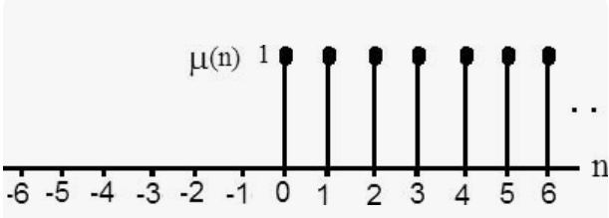
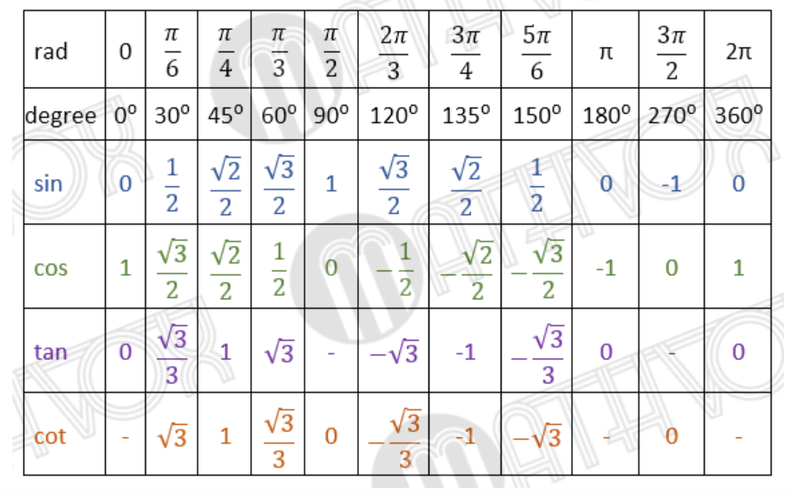




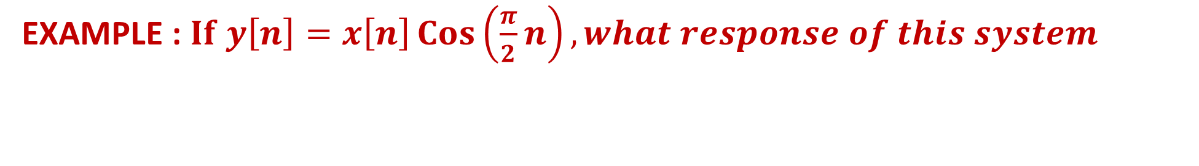




EXAMPLE : $If y\left[n\right]=x\left[n\right]\operatorname{Cos}\left(\frac{π}{2}n\right), what response of this system$
System = $Cos\left(\frac{π}{2}n\right)$
$$x\left[n\right]=Unit Step Sequence=$$
$$y\left[n\right]$$
SOLUTION
$y\left[n\right]=x\left[n\right]Cos\left(\frac{π}{2}n\right)=x\left[n\right]Cos\left(\frac{nπ}{2}\right)(1)$
$$Put n=0 in equation \left(1\right)$$
$y\left[0\right]=x\left[0\right]Cos\left(\frac{0×π}{2}\right)=\left(1\right)Cos\left(0\right)=1×1=1$
$$Put n=1 in equation \left(1\right)$$
$y\left[1\right]=x\left[1\right]Cos\left(\frac{1×π}{2}\right)=\left(1\right)Cos\left(\frac{π}{2}\right)=1×0=0$
$$Put n=2 in equation \left(1\right)$$
$y\left[2\right]=x\left[2\right]Cos\left(\frac{2×π}{2}\right)=\left(1\right)Cos\left(π\right)=1×\left(−1\right)=−1$
$$Put n=3 in equation \left(1\right)$$
$y\left[3\right]=x\left[3\right]Cos\left(\frac{3×π}{2}\right)=\left(1\right)Cos\left(\frac{3π}{2}\right)=1×0=0$

Slide 3



$$Put n=4 in equation \left(1\right)$$
$y\left[4\right]=x\left[4\right]Cos\left(\frac{4×π}{2}\right)=\left(1\right)Cos\left(2π\right)=1×1=1$
Plot output values
1
1
$$y\left[n\right]$$
$$n$$
0 1 2 3 4
-1
So, discrete System output is Periodic, when input is Unit Step
Answer

Slide 4
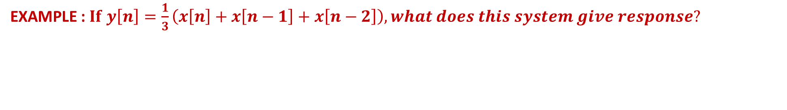
EXAMPLE : $If y\left[n\right]=\frac{1}{3}\left(x\left[n\right]+x\left[n−1\right]+x\left[n−2\right]\right), what does this system give response?$
System
SOLUTION
$y\left[n\right]=\frac{1}{3}\left(x\left[n\right]+x\left[n−1\right]+x\left[n−2\right]\right) (1)$
$$Put n=0 in equation \left(1\right)$$
$y\left[0\right]=\frac{1}{3}\left(x\left[0\right]+x\left[0−1\right]+x\left[0−2\right]\right)=\frac{1}{3}\left(1+x\left[−1\right]+x\left[−2\right]\right)=\frac{1}{3}\left(1+0+0\right)=\frac{1}{3}$
$$Put n=1 in equation \left(1\right)$$
$y\left[1\right]=\frac{1}{3}\left(x\left[1\right]+x\left[1−1\right]+x\left[1−2\right]\right)=\frac{1}{3}\left(1+x\left[0\right]+x\left[−1\right]\right)=\frac{1}{3}\left(1+1+0\right)=\frac{2}{3}$
$$Put n=2 in equation \left(1\right)$$
$y\left[2\right]=\frac{1}{3}\left(x\left[2\right]+x\left[2−1\right]+x\left[2−2\right]\right)=\frac{1}{3}\left(1+x\left[1\right]+x\left[0\right]\right)=\frac{1}{3}\left(1+1+1\right)=\frac{3}{3}=1$
$$Put n=3 in equation \left(1\right)$$
$y\left[3\right]=\frac{1}{3}\left(x\left[3\right]+x\left[3−1\right]+x\left[3−2\right]\right)=\frac{1}{3}\left(1+x\left[2\right]+x\left[1\right]\right)=\frac{1}{3}\left(1+1+1\right)=\frac{3}{3}=1$

Slide 5










$$Put n=4 in equation \left(1\right)$$
$y\left[4\right]=\frac{1}{3}\left(x\left[4\right]+x\left[4−1\right]+x\left[4−2\right]\right)=\frac{1}{3}\left(1+x\left[3\right]+x\left[2\right]\right)=\frac{1}{3}\left(1+1+1\right)=\frac{3}{3}=1$
$$Put n=5 in equation \left(1\right)$$
$y\left[5\right]=\frac{1}{3}\left(x\left[5\right]+x\left[5−1\right]+x\left[5−2\right]\right)=\frac{1}{3}\left(1+x\left[4\right]+x\left[3\right]\right)=\frac{1}{3}\left(1+1+1\right)=\frac{3}{3}=1$
$$1$$
$$1$$
$$1$$
$$1$$
. . .
$$\frac{2}{3}$$
$$\frac{1}{3}$$
$$y\left[n\right]$$
$$n$$
0 1 2 3 4 5

